Slide 1


Big Data Infrastructure
CS 489/698 Big Data Infrastructure (Winter 2016)
Week 12: Real-Time Data Analytics (1/2)
March 29, 2016
Jimmy Lin
David R. Cheriton School of Computer Science
University of Waterloo
These slides are available at http://lintool.github.io/bigdata-2016w/
This work is licensed under a Creative Commons Attribution-Noncommercial-Share Alike 3.0 United States See http://creativecommons.org/licenses/by-nc-sa/3.0/us/ for details

Slide 2
OLTP/OLAP Architecture
OLTP
OLAP
ETL (Extract, Transform, and Load)

Slide 3
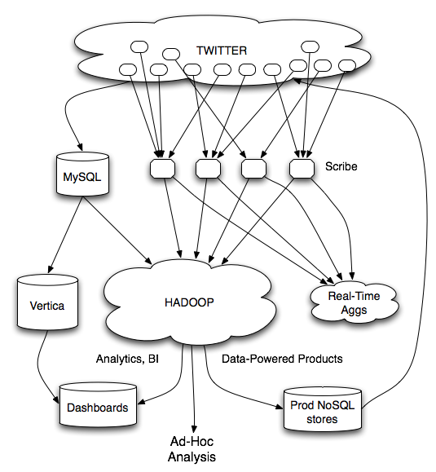
What’s the issue?
Twitter’s data warehousing architecture

Slide 4
real-time
vs.
online
vs.
streaming

Slide 5
What is a data stream?
Sequence of items:
Structured (e.g., tuples)
Ordered (implicitly or timestamped)
Arriving continuously at high volumes
Sometimes not possible to store entirely
Sometimes not possible to even examine all items

Slide 6
What to do with data streams?
Network traffic monitoring
Datacenter telemetry monitoring
Sensor networks monitoring
Credit card fraud detection
Stock market analysis
Online mining of click streams
Monitoring social media streams

Slide 7
What’s the scale? Packet data streams
Single 2 Gb/sec link; say avg. packet size is 50 bytes
Number of packets/sec = 5 million
Time per packet = 0.2 microseconds
If we only capture header information per packet: source/destination IP, time, no. of bytes, etc. – at least 10 bytes
50 MB per second
4+ TB per day
Per link!
What if you wanted to do deep-packet inspection?
Source: Minos Garofalakis, Berkeley CS 286

Slide 8
DBMS
What are the top (most frequent) 1000 (source, dest) pairs seen by R1 over the last month?
Off-line analysis – Data access is slow, expensive
Network Operations
Center (NOC)
How many distinct (source, dest) pairs have been seen by both R1 and R2 but not R3?
Set-Expression Query
BGP
R1
R2
Peer
R3
Converged IP/MPLS
Network
SELECT COUNT (R1.source, R1.dest)
FROM R1, R2
WHERE R1.source = R2.source
Enterprise Networks
DSL/Cable
Networks
PSTN
SQL Join Query
Source: Minos Garofalakis, Berkeley CS 286

Slide 9
Common Architecture
queries
DSMS
data feeds
DBMS
DSMS
data streams
queries
Data stream management system (DSMS) at observation points
Voluminous streams-in, reduced streams-out
Database management system (DBMS)
Outputs of DSMS can be treated as data feeds to databases
Source: Peter Bonz

Slide 10
OLTP/OLAP Architecture
OLTP
OLAP
ETL (Extract, Transform, and Load)

Slide 11
DBMS vs. DSMS
DBMS
Model: persistent relations
Relation: tuple set/bag
Data update: modifications
Query: transient
Query answer: exact
Query evaluation: arbitrary
Query plan: fixed
DSMS
Model: (mostly) transient relations
Relation: tuple sequence
Data update: appends
Query: persistent
Query answer: approximate
Query evaluation: one pass
Query plan: adaptive
Source: Peter Bonz

Slide 12
What makes it hard?
Intrinsic challenges:
Volume
Velocity
Limited storage
Strict latency requirements
System challenges:
Load balancing
Unreliable and out-of-order message delivery
Fault-tolerance
Consistency semantics (at most once, exactly once, at least once)

Slide 13
What exactly do you do?
“Standard” relational operations:
Select
Project
Transform (i.e., apply custom UDF)
Group by
Join
Aggregations
What else do you need to make this “work”?

Slide 14
Issues of Semantics
Group by… aggregate
When do you stop grouping and start aggregating?
Joining a stream and a static source
Simple lookup
Joining two streams
How long do you wait for the join key in the other stream?
Joining two streams, group by and aggregation
When do you stop joining?
What’s the solution?

Slide 15
Windows
Mechanism for extracting finite relations from an infinite stream
Windows restrict processing scope:
Windows based on ordering attributes (e.g., time)
Windows based on item (record) counts
Windows based on explicit markers (e.g., punctuations)
Variants (e.g., some semantic partitioning constraint)

Slide 16
Windows on Ordering Attributes
Assumes the existence of an attribute that defines the order of stream elements (e.g., time)
Let T be the window size in units of the ordering attribute
t₁
t₂
t₃
t₄
t₁'
t₂’
t₃’
t₄’
sliding window
t_{i}’ – t_{i} = T
t₁
t₂
t₃
tumbling window
t_{i+1} – t_{i} = T
Source: Peter Bonz

Slide 17
Windows on Counts
Window of size N elements (sliding, tumbling) over the stream
Challenges:
Problematic with non-unique timestamps: non-deterministic output
Unpredictable window size (and storage requirements)
t₁
t₂
t₁'
t₃
t₂’
t₃’
t₄’
Source: Peter Bonz

Slide 18
Windows from “Punctuations”
Application-inserted “end-of-processing”
Example: stream of actions… “end of user session”
Properties
Advantage: application-controlled semantics
Disadvantage: unpredictable window size (too large or too small)

Slide 19
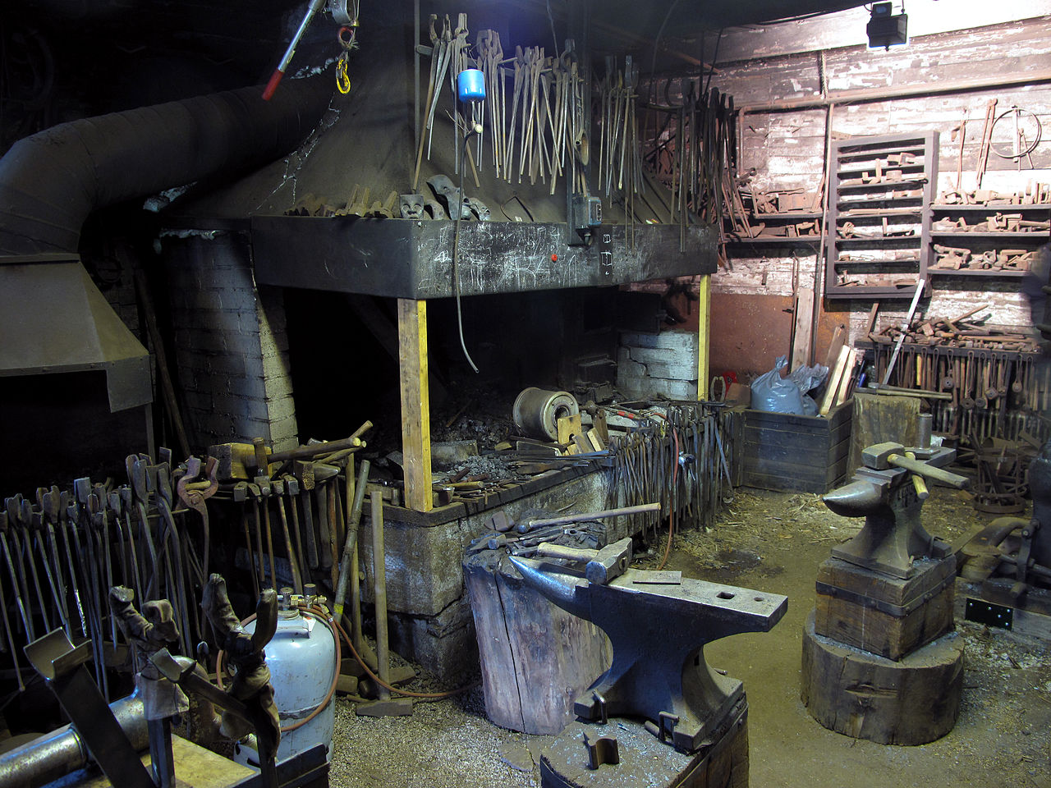
Common Techniques
Source: Wikipedia (Forge)

Slide 20
“Hello World” Stream Processing
Problem:
Count the frequency of items in the stream
Why?
Take some action when frequency exceeds a threshold
Data mining: raw counts → co-occurring counts → association rules

Slide 21
The Raw Stream…
Source: Peter Bonz

Slide 22
Divide Into Windows…
Source: Peter Bonz

Slide 23
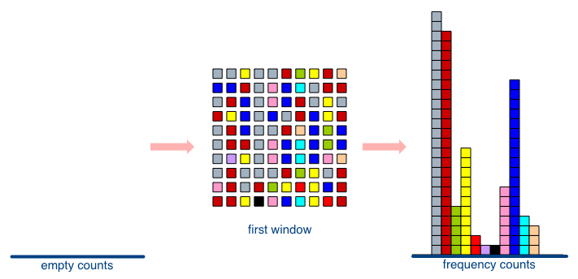
First Window
Source: Peter Bonz

Slide 24
Second Window
Source: Peter Bonz

Slide 25
Window Counting
What’s the issue?
Lessons learned?
Solutions are approximate (or lossy)

Slide 26
General Strategies
Sampling
Hashing

Slide 27
Reservoir Sampling
Task: select s elements from a stream of size N with uniform probability
N can be very very large
We might not even know what N is! (infinite stream)
Solution: Reservoir sampling
Store first s elements
For the k-th element thereafter, keep with probability s/k (randomly discard an existing element)
Example: s = 10
Keep first 10 elements
11th element: keep with 10/11
12th element: keep with 10/12
…

Slide 28
Reservoir Sampling: How does it work?
Example: s = 10
Keep first 10 elements
11th element: keep with 10/11
General case: at the (k + 1)th element
Probability of selecting each item up until now is s/k
Probability existing item is discarded: s/(k+1) × 1/s = 1/(k + 1)
Probability existing item survives: k/(k + 1)
Probability each item survives to (k + 1)th round: (s/k) × k/(k + 1) = s/(k + 1)
If we decide to keep it: sampled uniformly by definition
probability existing item is discarded: 10/11 × 1/10 = 1/11
probability existing item survives: 10/11

Slide 29
Hashing for Three Common Tasks
Cardinality estimation
What’s the cardinality of set S?
How many unique visitors to this page?
Set membership
Is x a member of set S?
Has this user seen this ad before?
Frequency estimation
How many times have we observed x?
How many queries has this user issued?
HashSet
HLL counter
HashSet
Bloom Filter
HashMap
CMS

Slide 30
HyperLogLog Counter
Task: cardinality estimation of set
size() → number of unique elements in the set
Observation: hash each item and examine the hash code
On expectation, 1/2 of the hash codes will start with 1
On expectation, 1/4 of the hash codes will start with 01
On expectation, 1/8 of the hash codes will start with 001
On expectation, 1/16 of the hash codes will start with 0001
…
How do we take advantage of this observation?

Slide 31
Bloom Filters
Task: keep track of set membership
put(x) → insert x into the set
contains(x) → yes if x is a member of the set
Components
m-bit bit vector
k hash functions: h₁ … h_{k}
0
0
0
0
0
0
0
0
0
0
0
0

Slide 32
Bloom Filters: put
put
x
h₁(x) = 2
h₂(x) = 5
h₃(x) = 11
0
0
0
0
0
0
0
0
0
0
0
0

Slide 33
Bloom Filters: put
put
x
0
1
0
0
1
0
0
0
0
0
1
0

Slide 34
Bloom Filters: contains
contains
x
h₁(x) = 2
h₂(x) = 5
h₃(x) = 11
0
1
0
0
1
0
0
0
0
0
1
0

Slide 35
Bloom Filters: contains
contains
x
h₁(x) = 2
h₂(x) = 5
h₃(x) = 11
A[h₁(x)]
A[h₂(x)]
AND = YES
A[h₃(x)]
0
1
0
0
1
0
0
0
0
0
1
0

Slide 36
Bloom Filters: contains
contains
y
h₁(y) = 2
h₂(y) = 6
h₃(y) = 9
0
1
0
0
1
0
0
0
0
0
1
0

Slide 37
Bloom Filters: contains
contains
y
h₁(y) = 2
h₂(y) = 6
h₃(y) = 9
A[h₁(y)]
A[h₂(y)]
AND = NO
A[h₃(y)]
0
1
0
0
1
0
0
0
0
0
1
0
What’s going on here?

Slide 38
Bloom Filters
Error properties: contains(x)
False positives possible
No false negatives
Usage:
Constraints: capacity, error probability
Tunable parameters: size of bit vector m, number of hash functions k

Slide 39
Count-Min Sketches
Task: frequency estimation
put(x) → increment count of x by one
get(x) → returns the frequency of x
Components
k hash functions: h₁ … h_{k}
m by k array of counters
m
0
0
0
0
0
0
0
0
0
0
0
0
0
0
0
0
0
0
0
0
0
0
0
0
k
0
0
0
0
0
0
0
0
0
0
0
0
0
0
0
0
0
0
0
0
0
0
0
0

Slide 40
Count-Min Sketches: put
put
x
h₁(x) = 2
h₂(x) = 5
h₃(x) = 11
h₄(x) = 4
0
0
0
0
0
0
0
0
0
0
0
0
0
0
0
0
0
0
0
0
0
0
0
0
0
0
0
0
0
0
0
0
0
0
0
0
0
0
0
0
0
0
0
0
0
0
0
0

Slide 41
Count-Min Sketches: put
put
x
0
1
0
0
0
0
0
0
0
0
0
0
0
0
0
0
1
0
0
0
0
0
0
0
0
0
0
0
0
0
0
0
0
0
1
0
0
0
0
1
0
0
0
0
0
0
0
0

Slide 42
Count-Min Sketches: put
put
x
h₁(x) = 2
h₂(x) = 5
h₃(x) = 11
h₄(x) = 4
0
1
0
0
0
0
0
0
0
0
0
0
0
0
0
0
1
0
0
0
0
0
0
0
0
0
0
0
0
0
0
0
0
0
1
0
0
0
0
1
0
0
0
0
0
0
0
0

Slide 43
Count-Min Sketches: put
put
x
0
2
0
0
0
0
0
0
0
0
0
0
0
0
0
0
2
0
0
0
0
0
0
0
0
0
0
0
0
0
0
0
0
0
2
0
0
0
0
2
0
0
0
0
0
0
0
0

Slide 44
Count-Min Sketches: put
put
y
h₁(y) = 6
h₂(y) = 5
h₃(y) = 12
h₄(y) = 2
0
2
0
0
0
0
0
0
0
0
0
0
0
0
0
0
2
0
0
0
0
0
0
0
0
0
0
0
0
0
0
0
0
0
2
0
0
0
0
2
0
0
0
0
0
0
0
0

Slide 45
Count-Min Sketches: put
put
y
0
2
0
0
0
1
0
0
0
0
0
0
0
0
0
0
3
0
0
0
0
0
0
0
0
0
0
0
0
0
0
0
0
0
2
1
0
1
0
2
0
0
0
0
0
0
0
0

Slide 46
Count-Min Sketches: get
get
x
h₁(x) = 2
h₂(x) = 5
h₃(x) = 11
h₄(x) = 4
0
2
0
0
0
1
0
0
0
0
0
0
0
0
0
0
3
0
0
0
0
0
0
0
0
0
0
0
0
0
0
0
0
0
2
1
0
1
0
2
0
0
0
0
0
0
0
0

Slide 47
Count-Min Sketches: get
get
x
h₁(x) = 2
h₂(x) = 5
h₃(x) = 11
h₄(x) = 4
A[h₁(x)]
A[h₂(x)]
MIN = 2
A[h₃(x)]
A[h₄(x)]
0
2
0
0
0
1
0
0
0
0
0
0
0
0
0
0
3
0
0
0
0
0
0
0
0
0
0
0
0
0
0
0
0
0
2
1
0
1
0
2
0
0
0
0
0
0
0
0

Slide 48
Count-Min Sketches: get
get
y
h₁(y) = 6
h₂(y) = 5
h₃(y) = 12
h₄(y) = 2
0
2
0
0
0
1
0
0
0
0
0
0
0
0
0
0
3
0
0
0
0
0
0
0
0
0
0
0
0
0
0
0
0
0
2
1
0
1
0
2
0
0
0
0
0
0
0
0

Slide 49
Count-Min Sketches: get
get
y
h₁(y) = 6
h₂(y) = 5
h₃(y) = 12
h₄(y) = 2
A[h₁(y)]
A[h₂(y)]
MIN = 1
A[h₃(y)]
A[h₄(y)]
0
2
0
0
0
1
0
0
0
0
0
0
0
0
0
0
3
0
0
0
0
0
0
0
0
0
0
0
0
0
0
0
0
0
2
1
0
1
0
2
0
0
0
0
0
0
0
0

Slide 50
Count-Min Sketches
Error properties:
Reasonable estimation of heavy-hitters
Frequent over-estimation of tail
Usage:
Constraints: number of distinct events, distribution of events, error bounds
Tunable parameters: number of counters m, number of hash functions k, size of counters

Slide 51
Three Common Tasks
Cardinality estimation
What’s the cardinality of set S?
How many unique visitors to this page?
Set membership
Is x a member of set S?
Has this user seen this ad before?
Frequency estimation
How many times have we observed x?
How many queries has this user issued?
HashSet
HLL counter
HashSet
Bloom Filter
HashMap
CMS

Slide 52
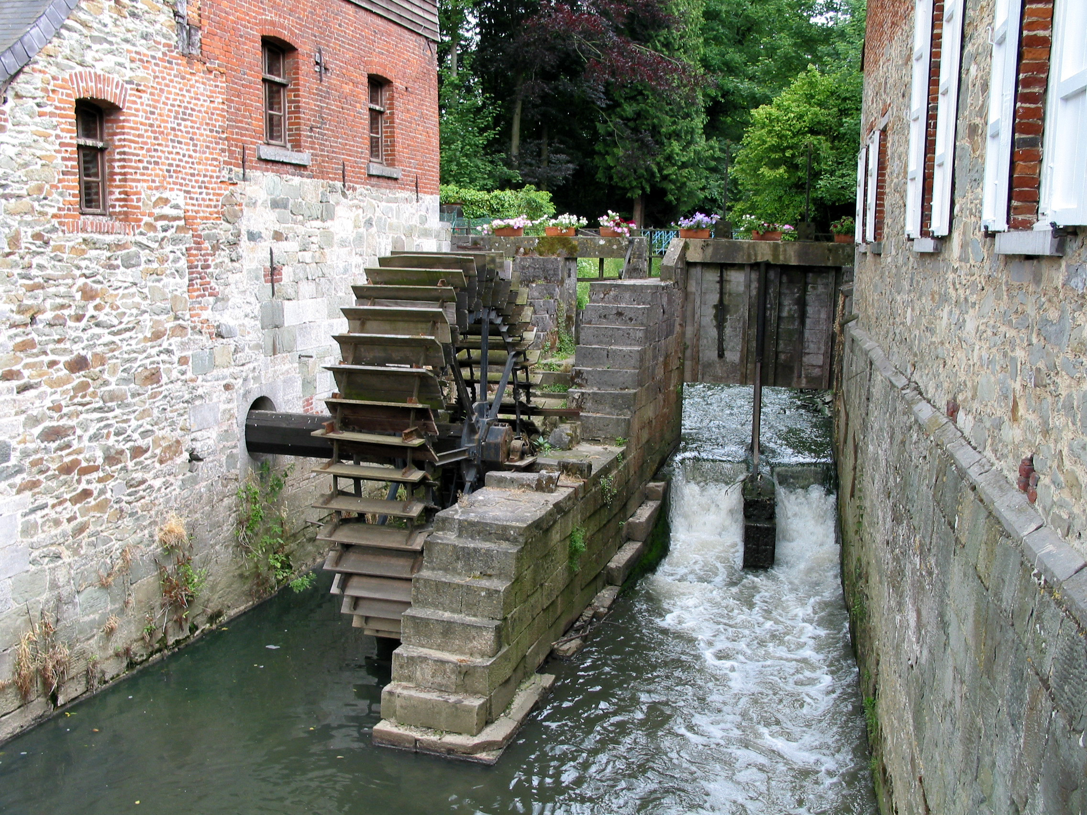
Next time:
Stream Processing Architectures
Source: Wikipedia (River)

Slide 53

Questions?
Source: Wikipedia (Japanese rock garden)

